Slide 1

Open MS Access through Citrix

Slide 2
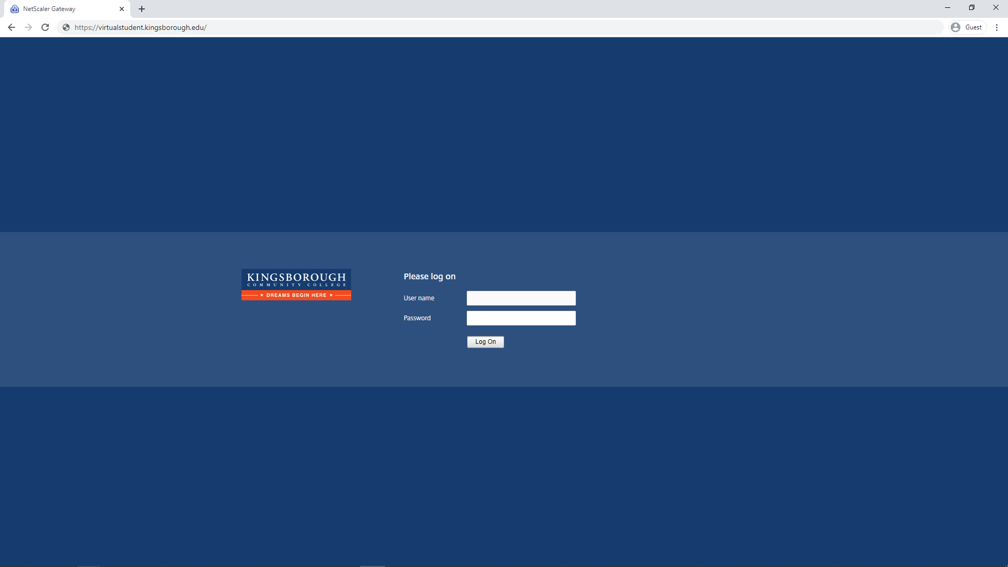
Go to “https://Virtualstudent.Kingsborough.edu”

Slide 3
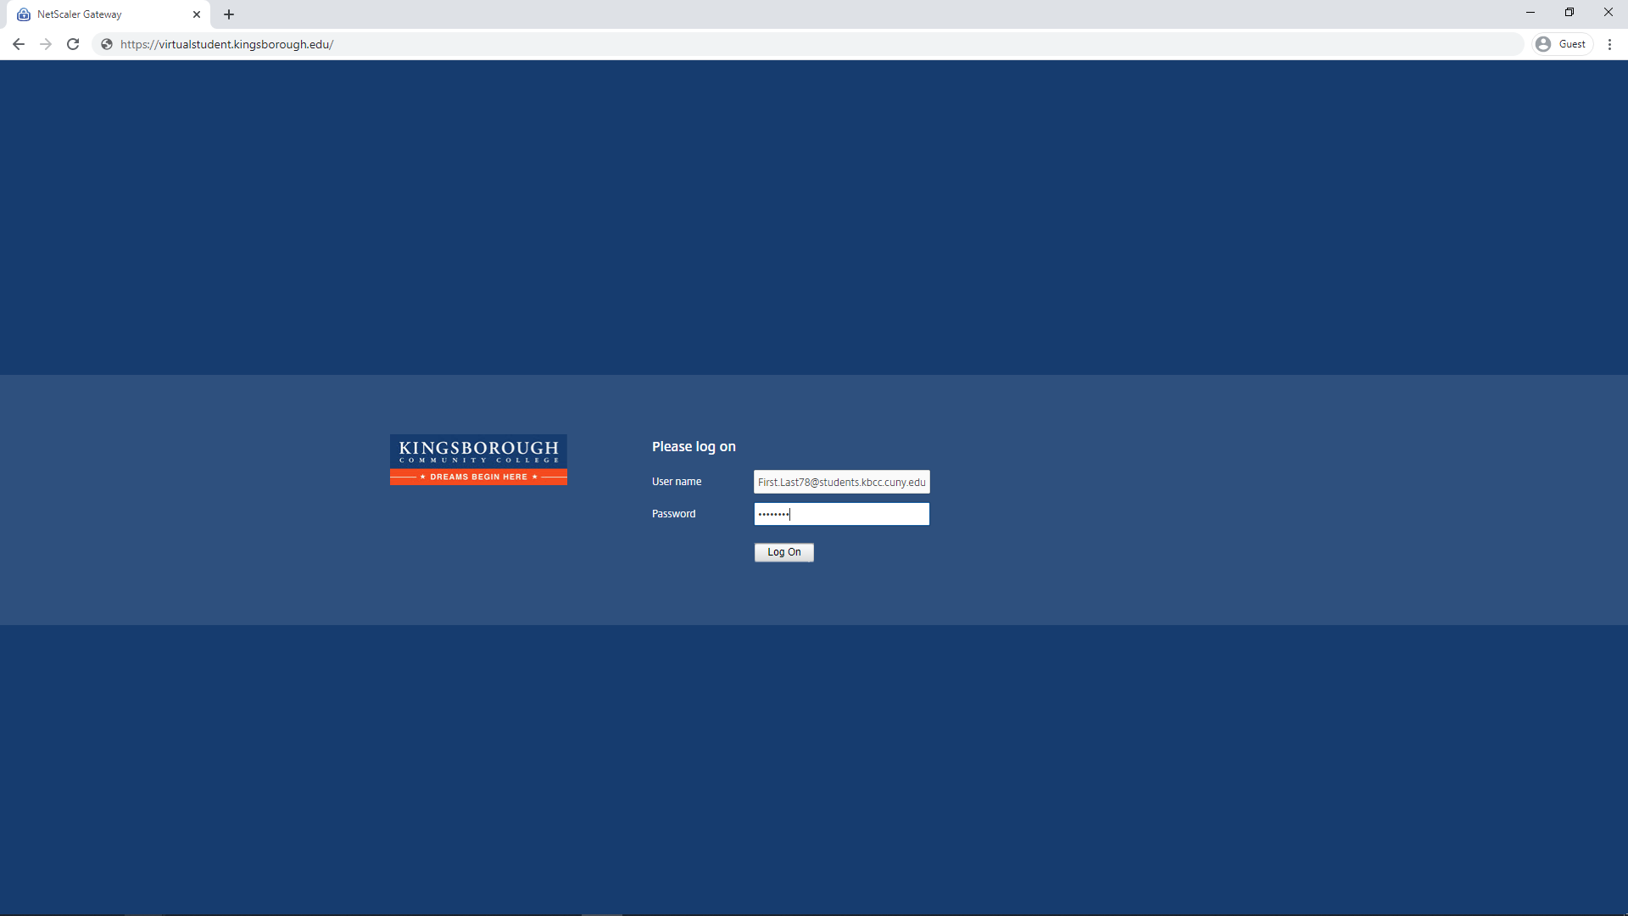
Enter your Full student email address and password. Then click “Log On”

Slide 4
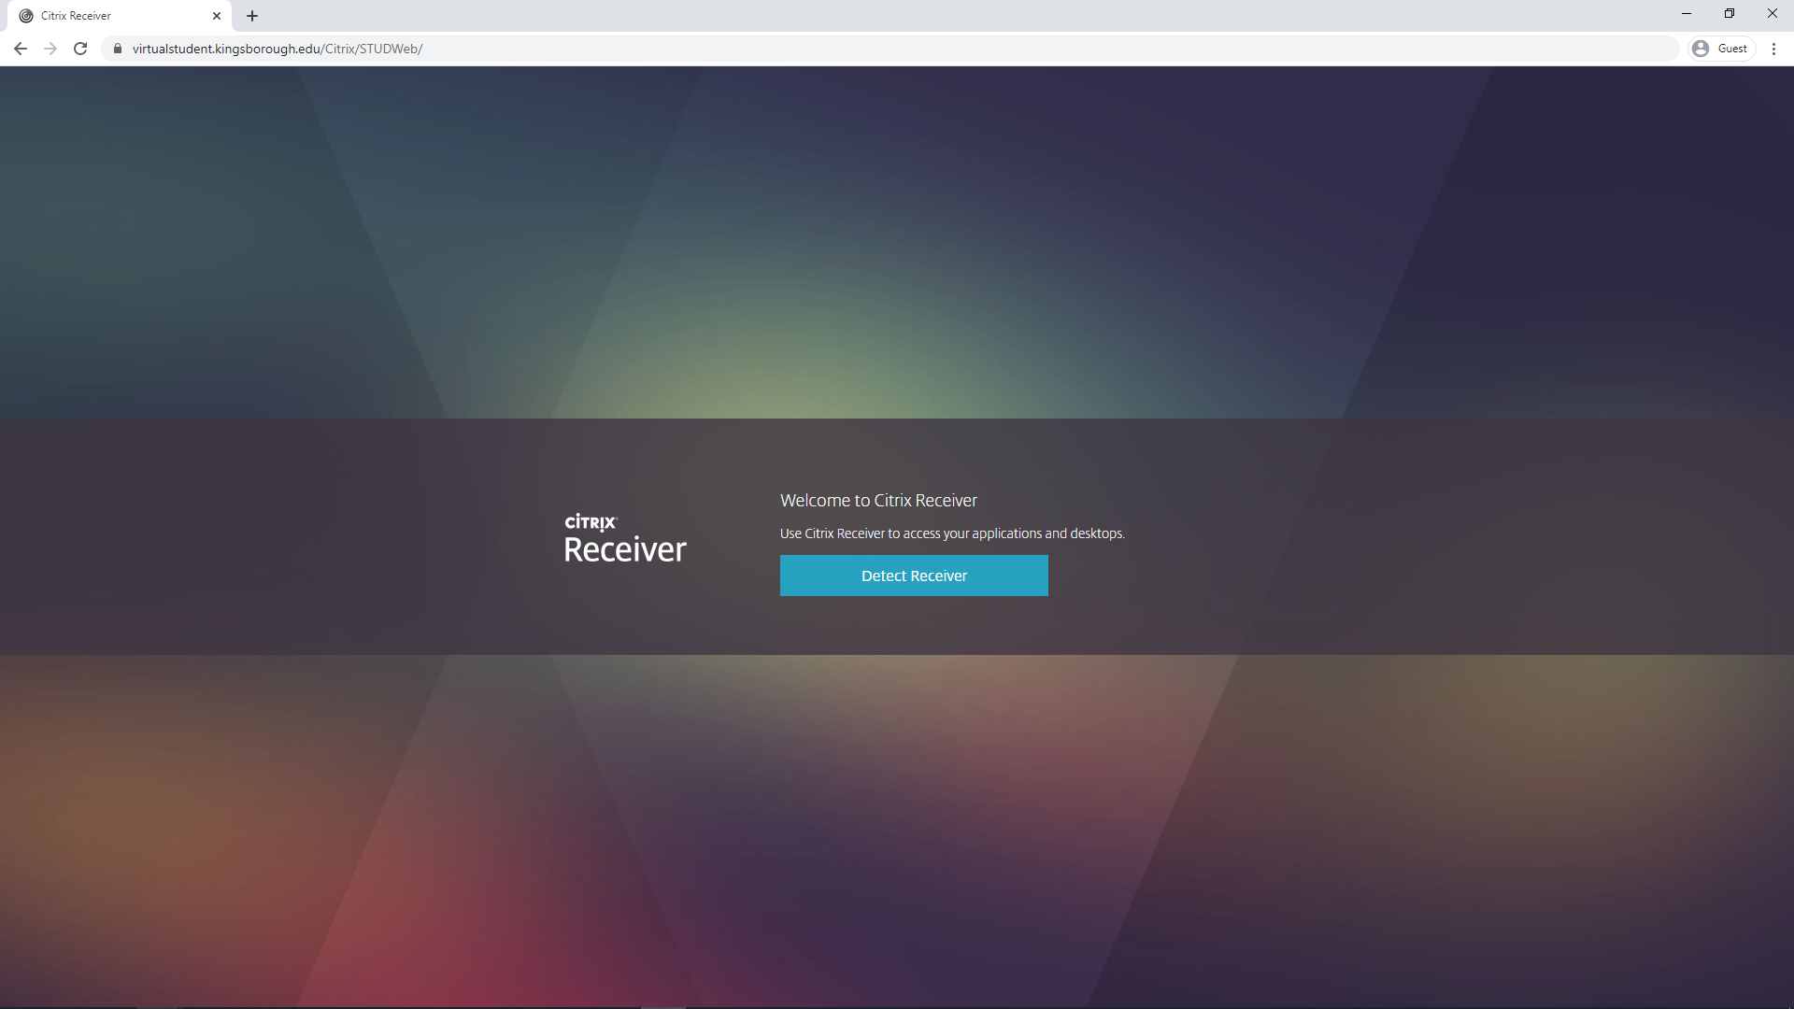
Click “Detect Receiver”

Slide 5
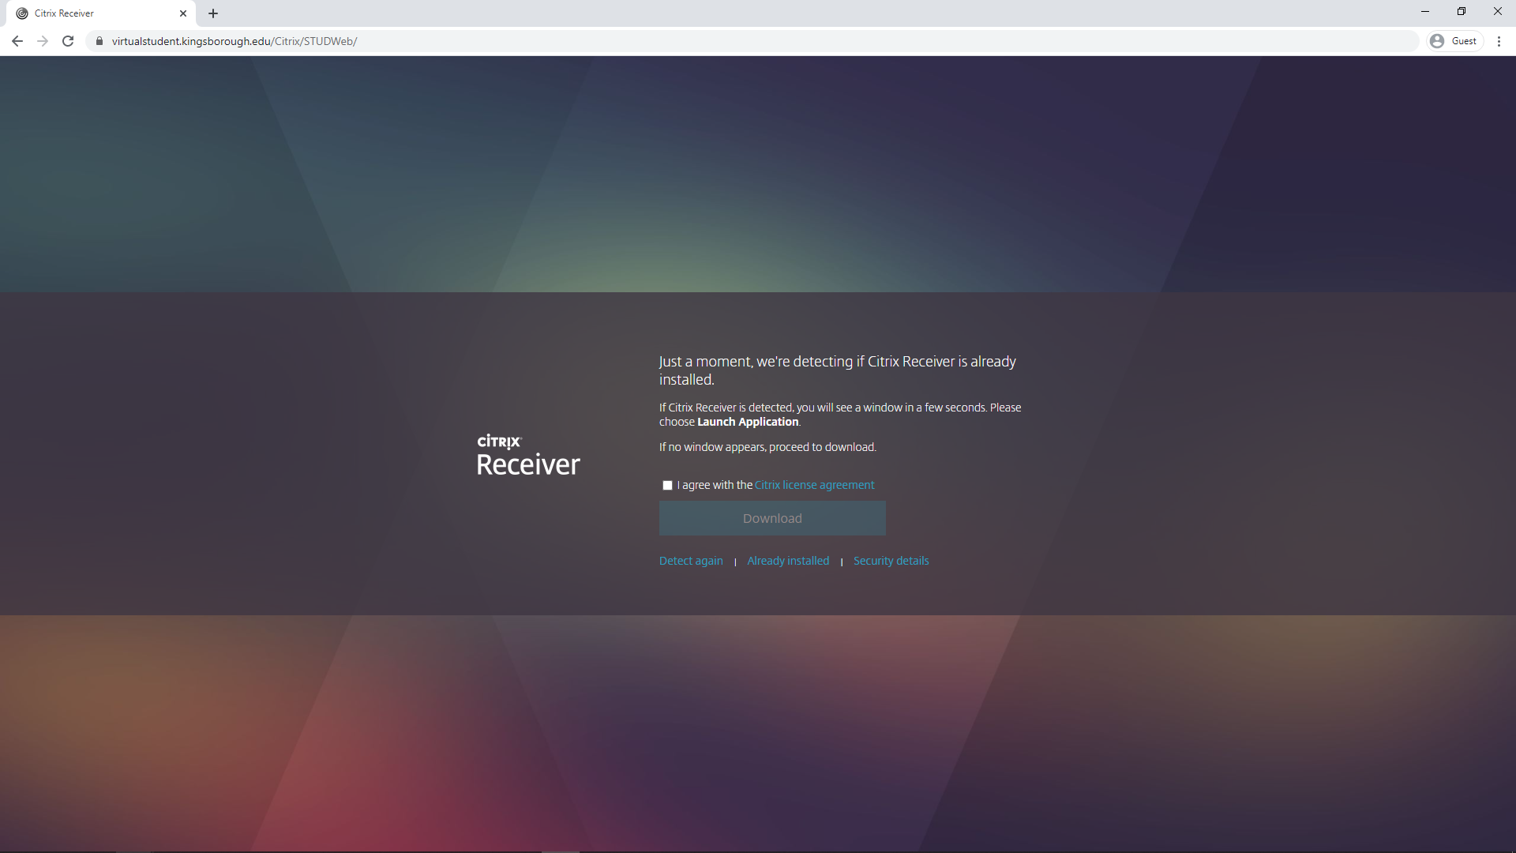
accept the Citrix license agreement

Slide 6
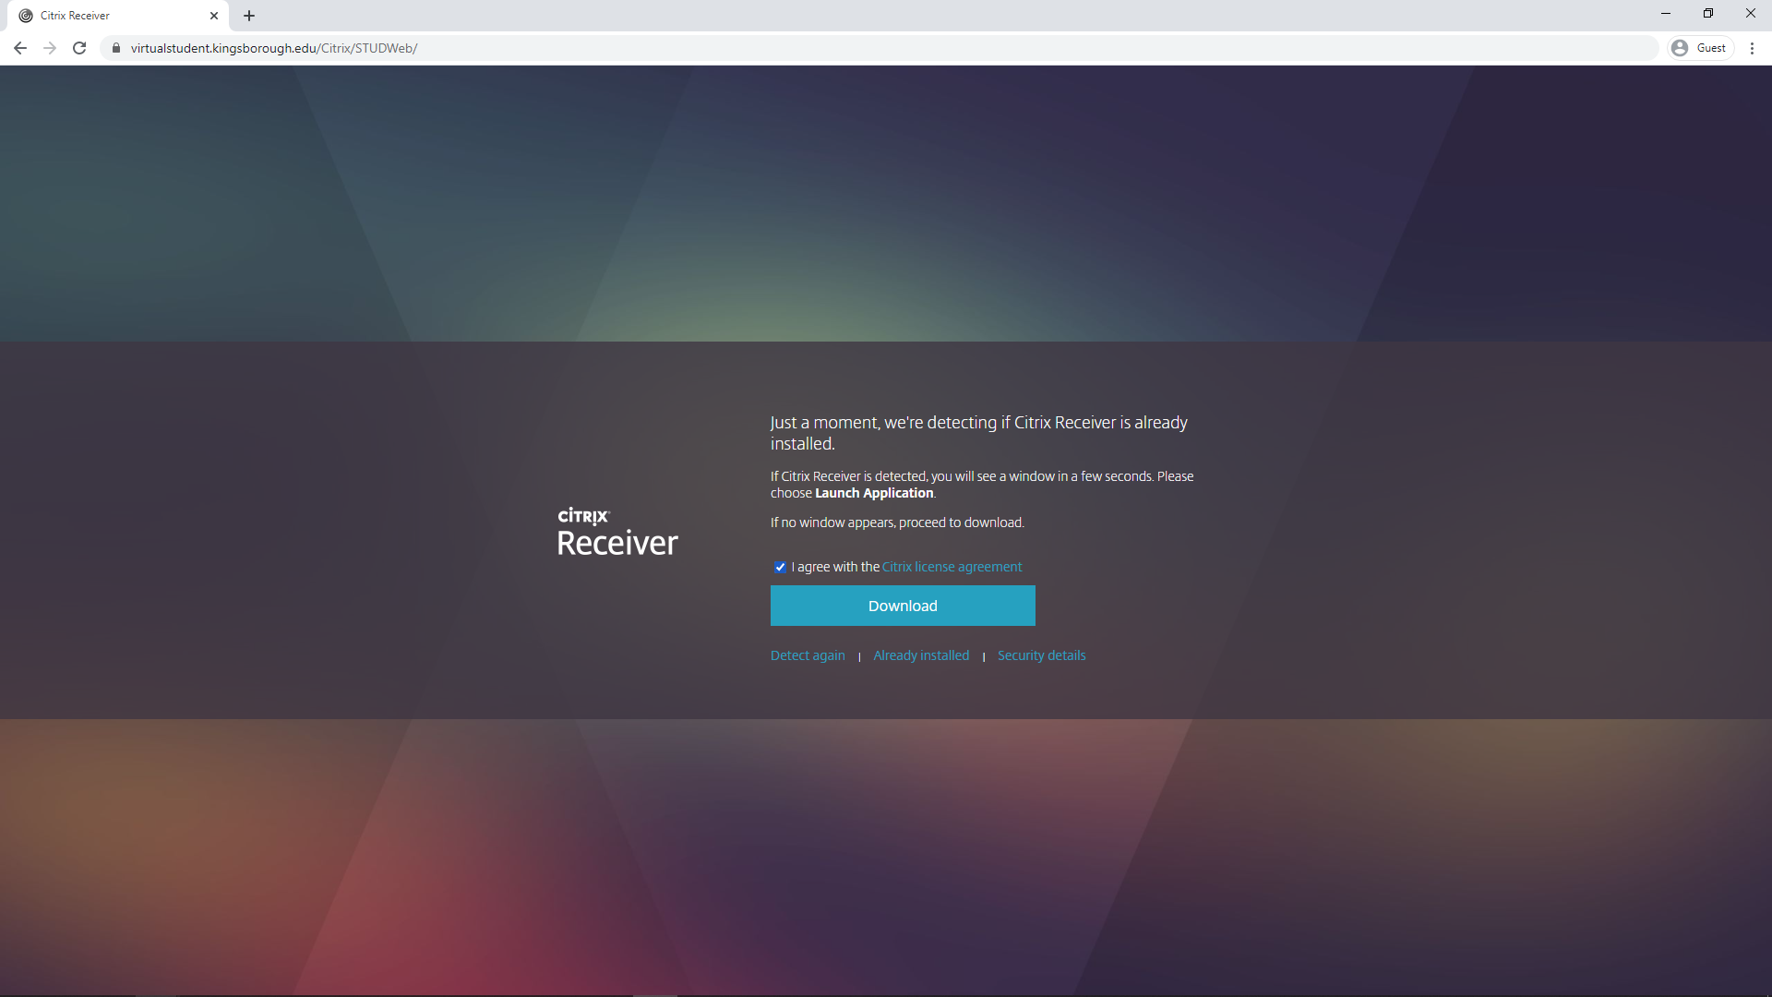
Click “Download”

Slide 7
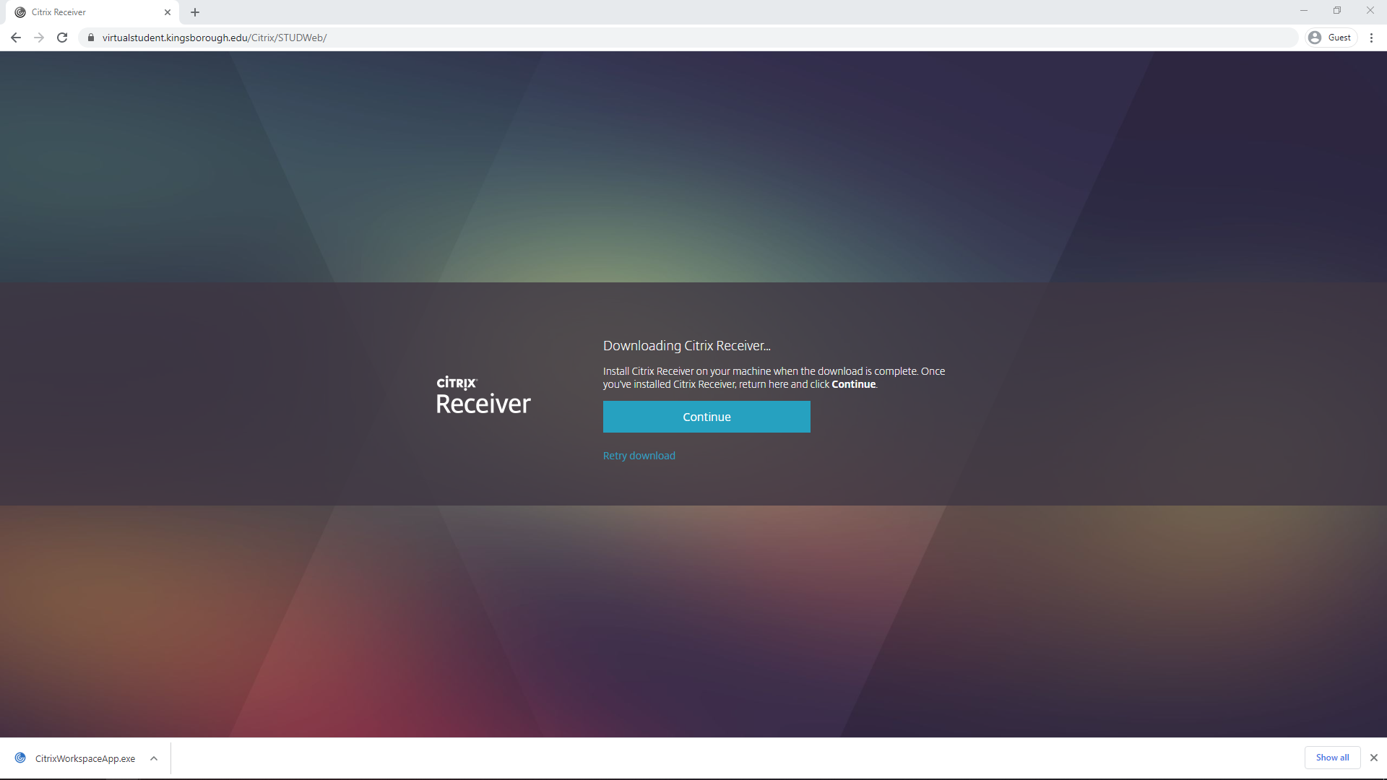
Launch the Citrix client installer that downloaded

Slide 8
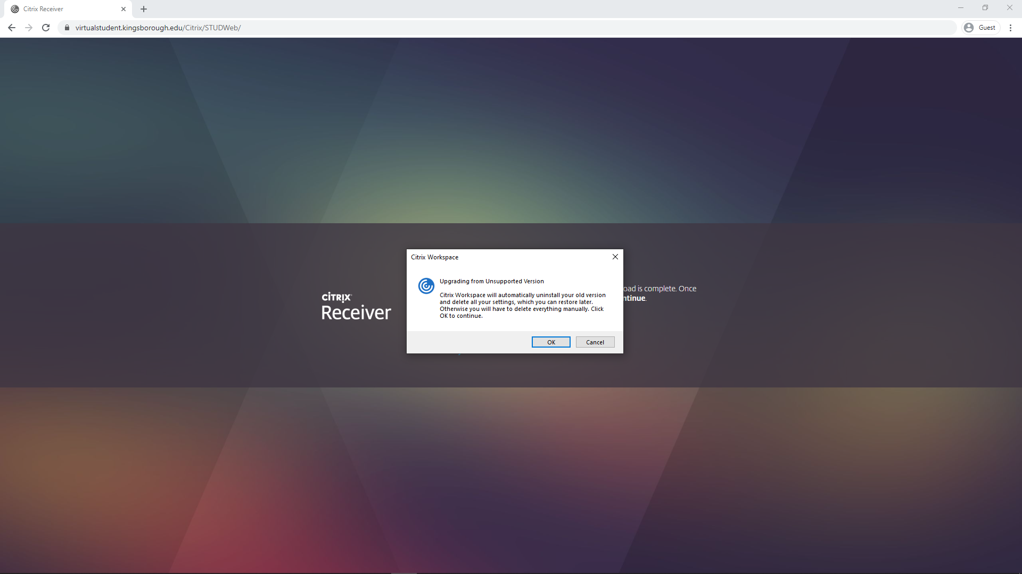

Slide 9
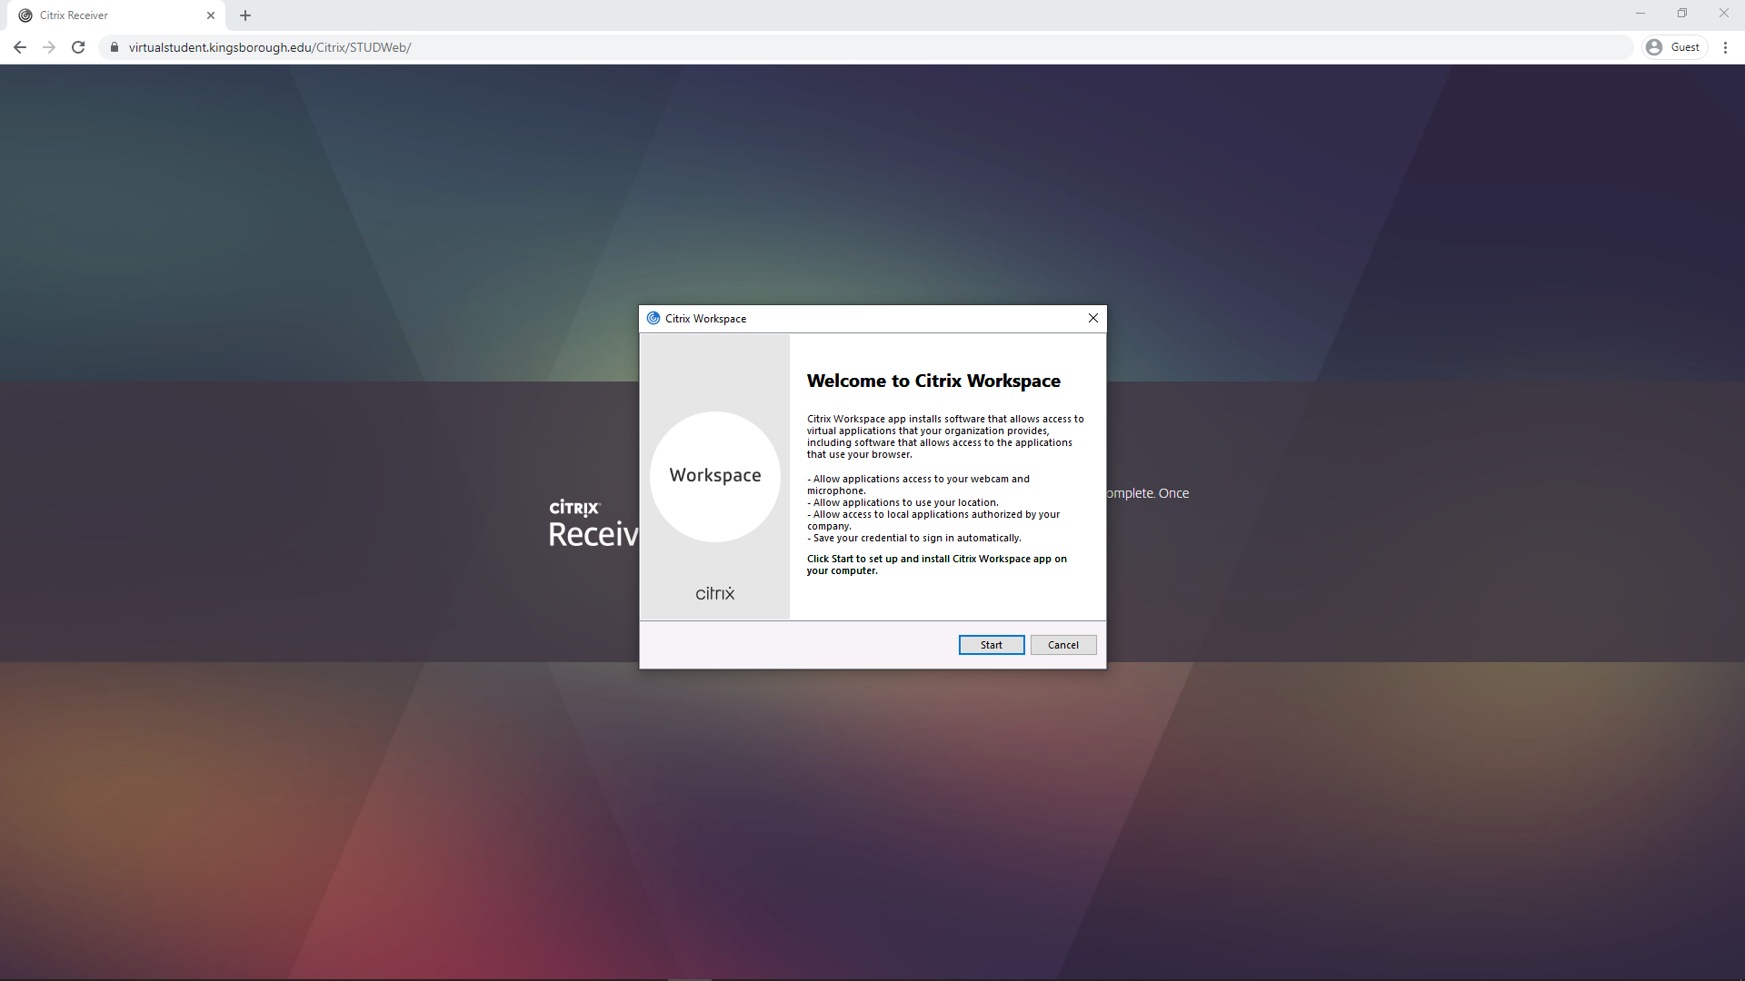
Click “Start”

Slide 10
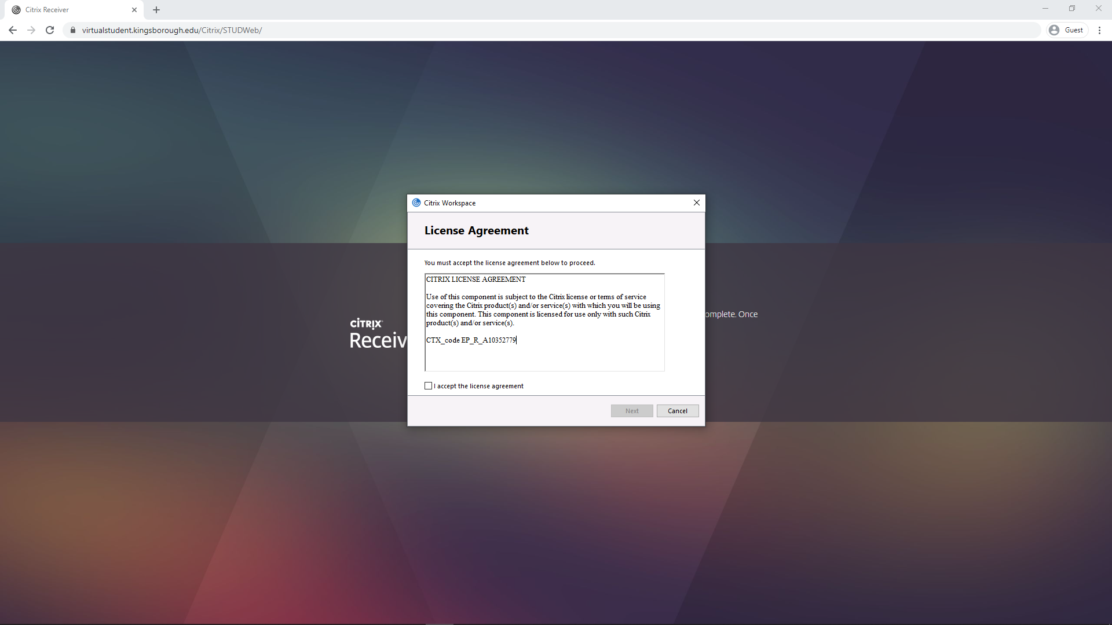
Accept the license agreement

Slide 11

Click “Next”

Slide 12
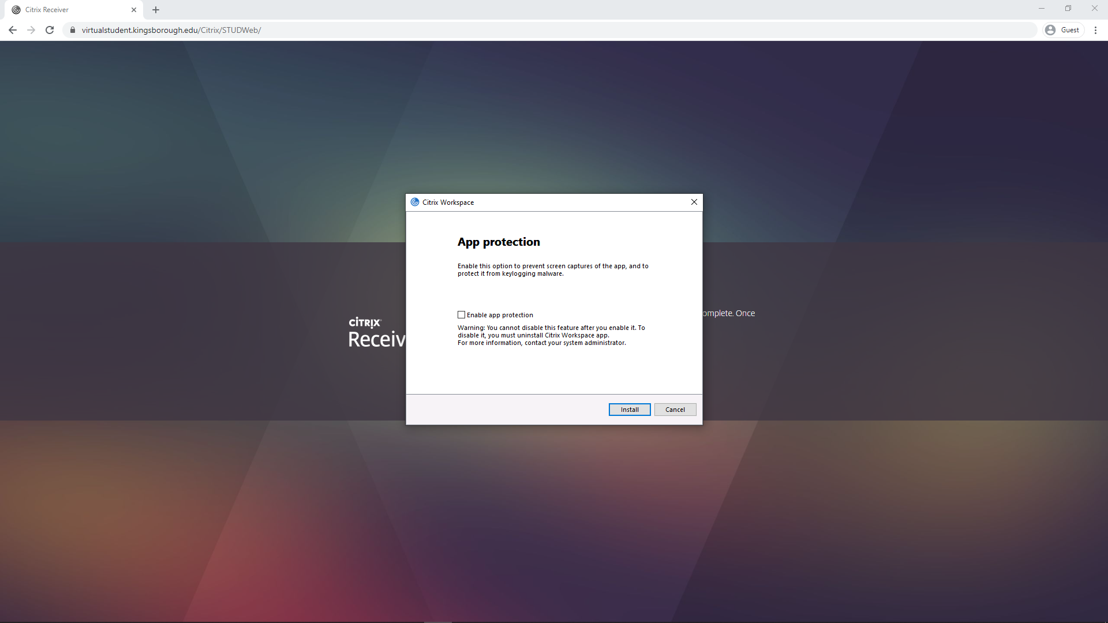
Click “Install”

Slide 13
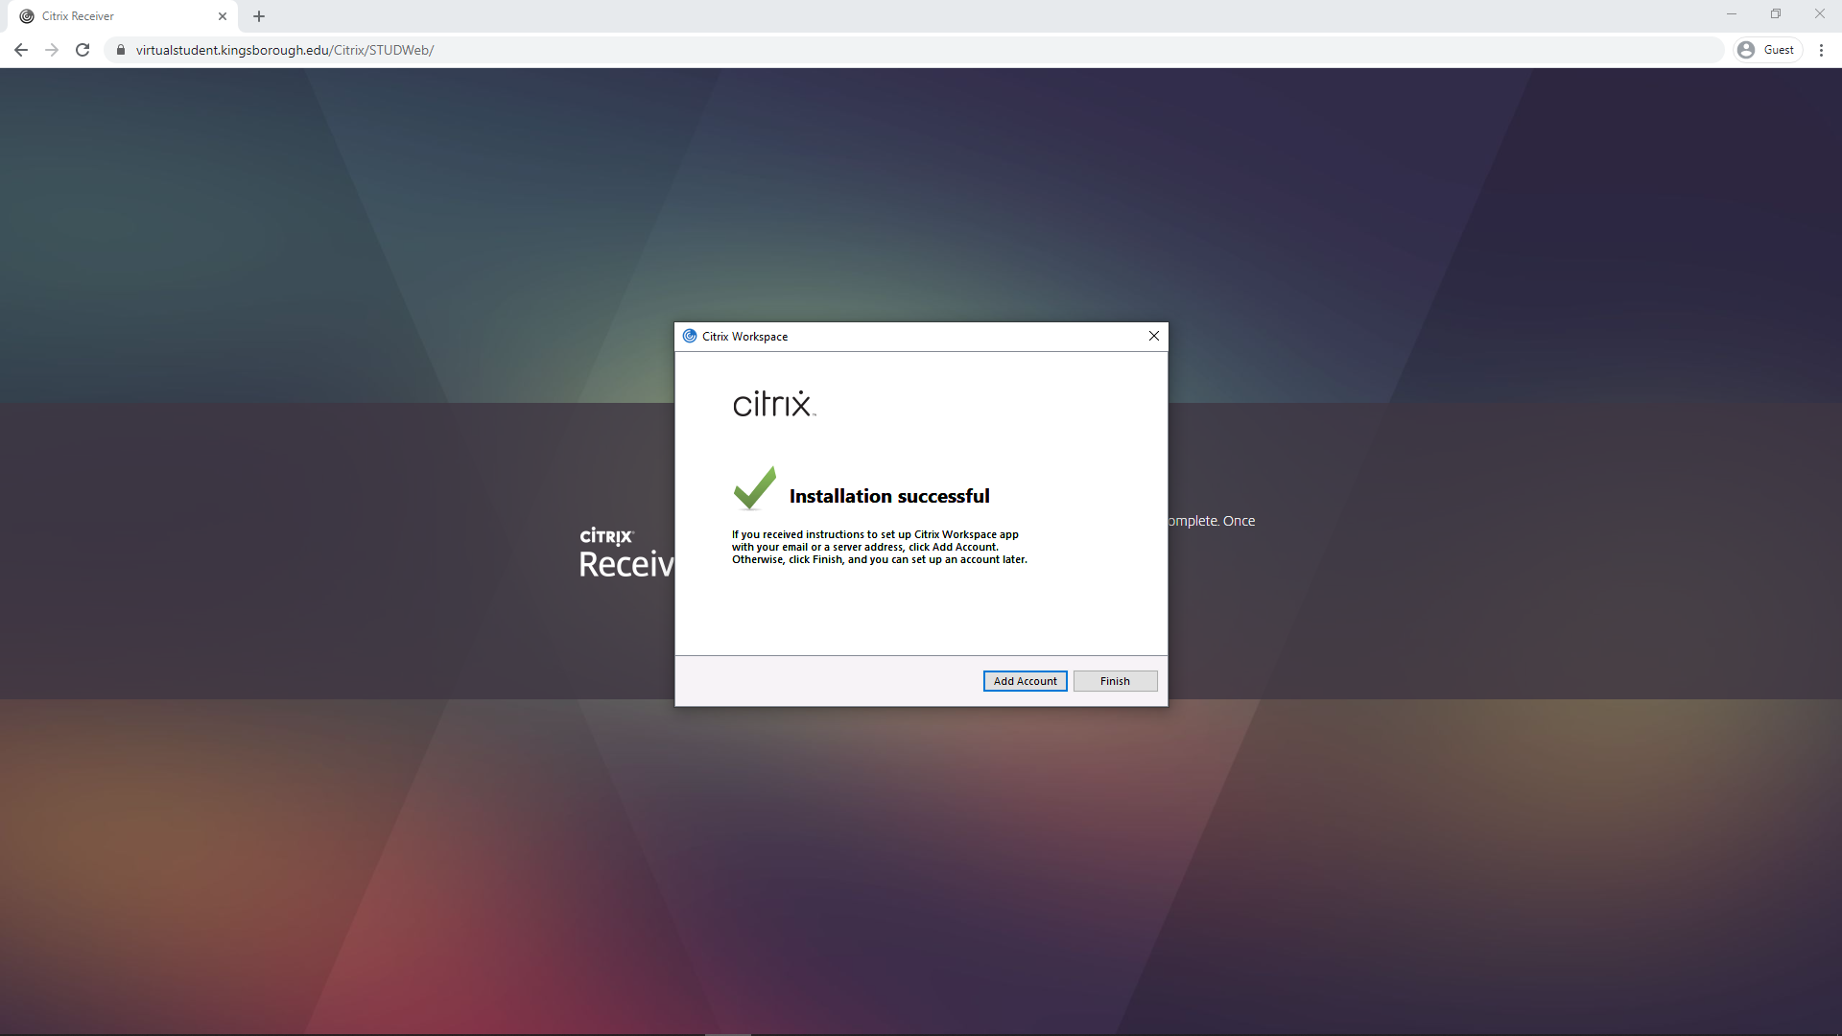
Click “Finish”

Slide 14
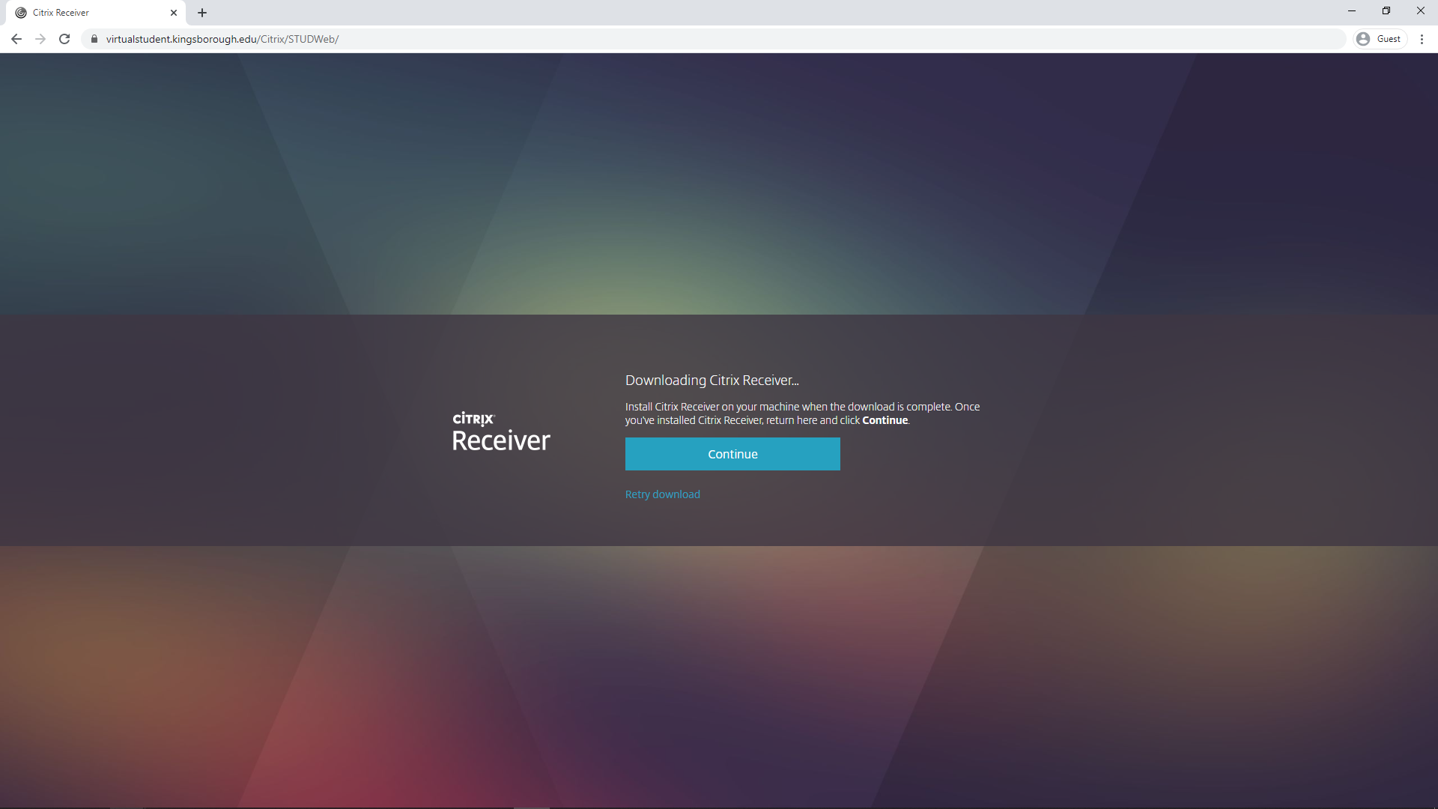
Go back to the website and click “Continue”

Slide 15
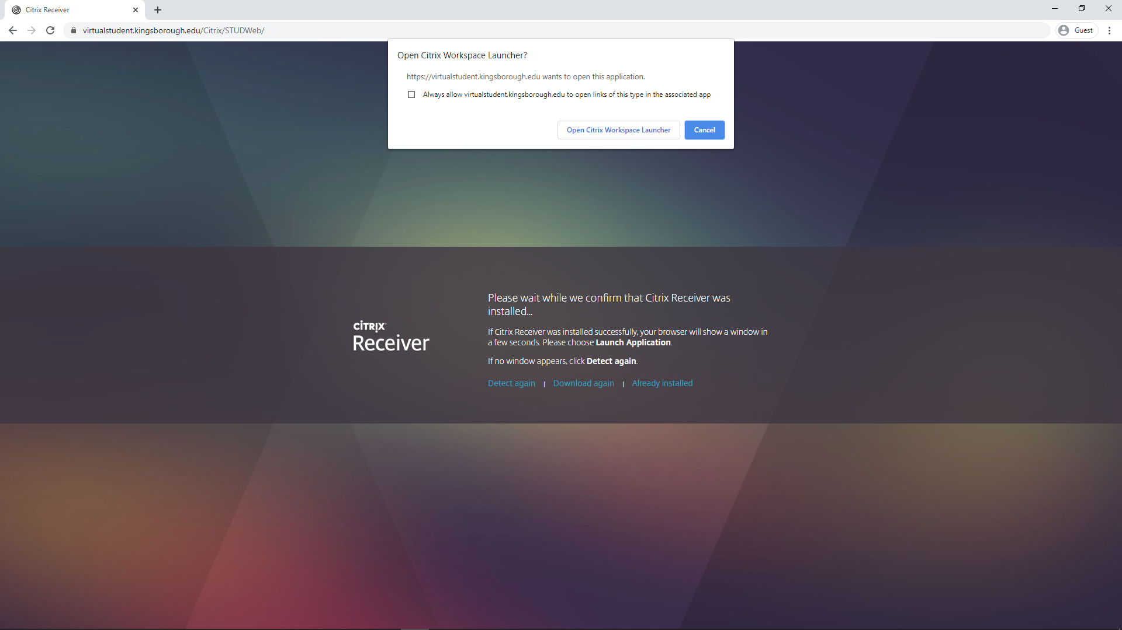
Click “Open Citrix Workspace Launcher”

Slide 16
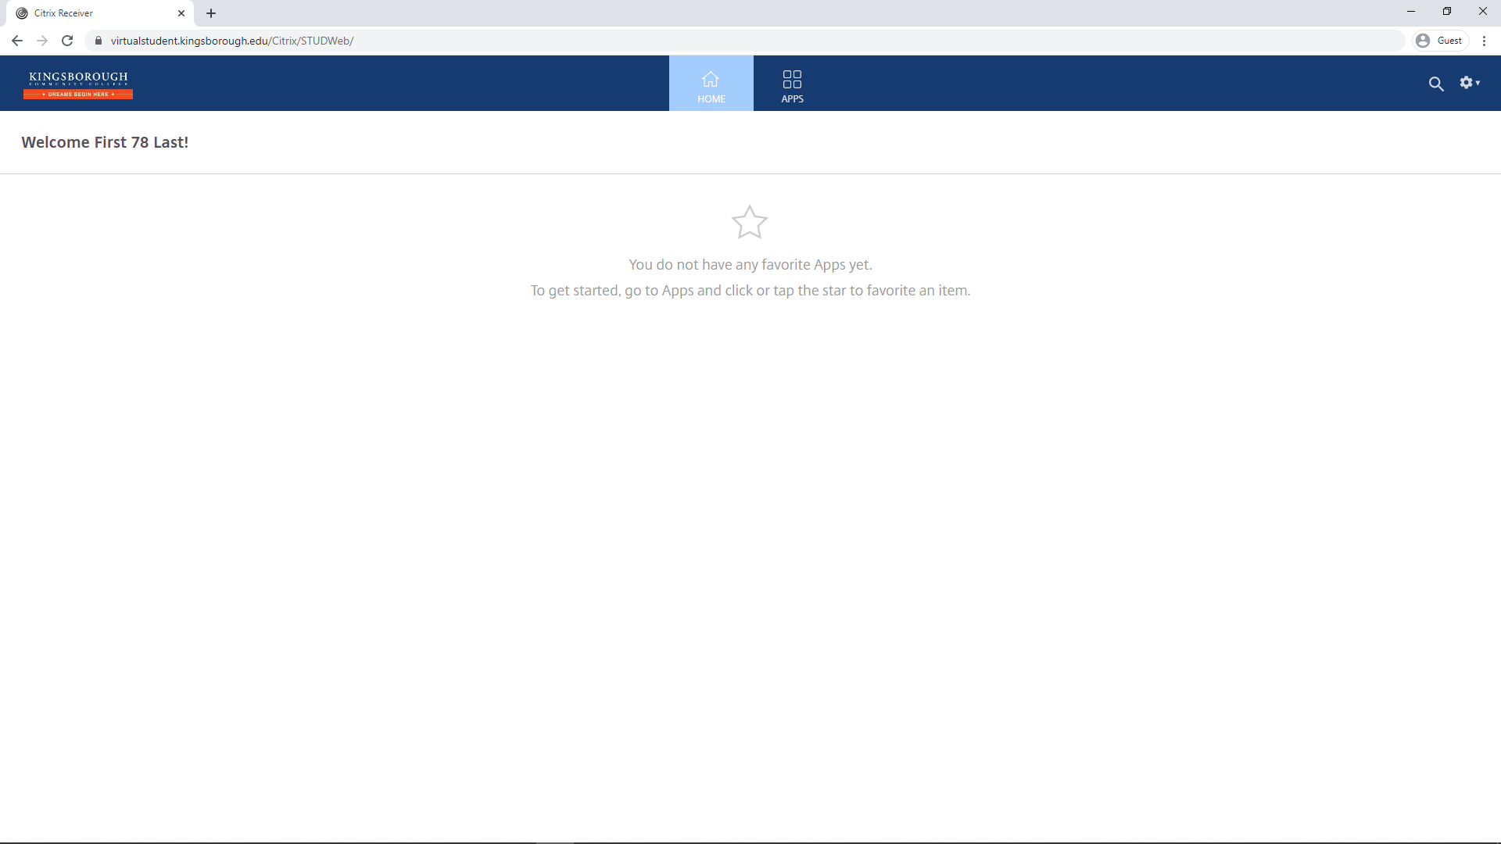
Click “Apps”

Slide 17
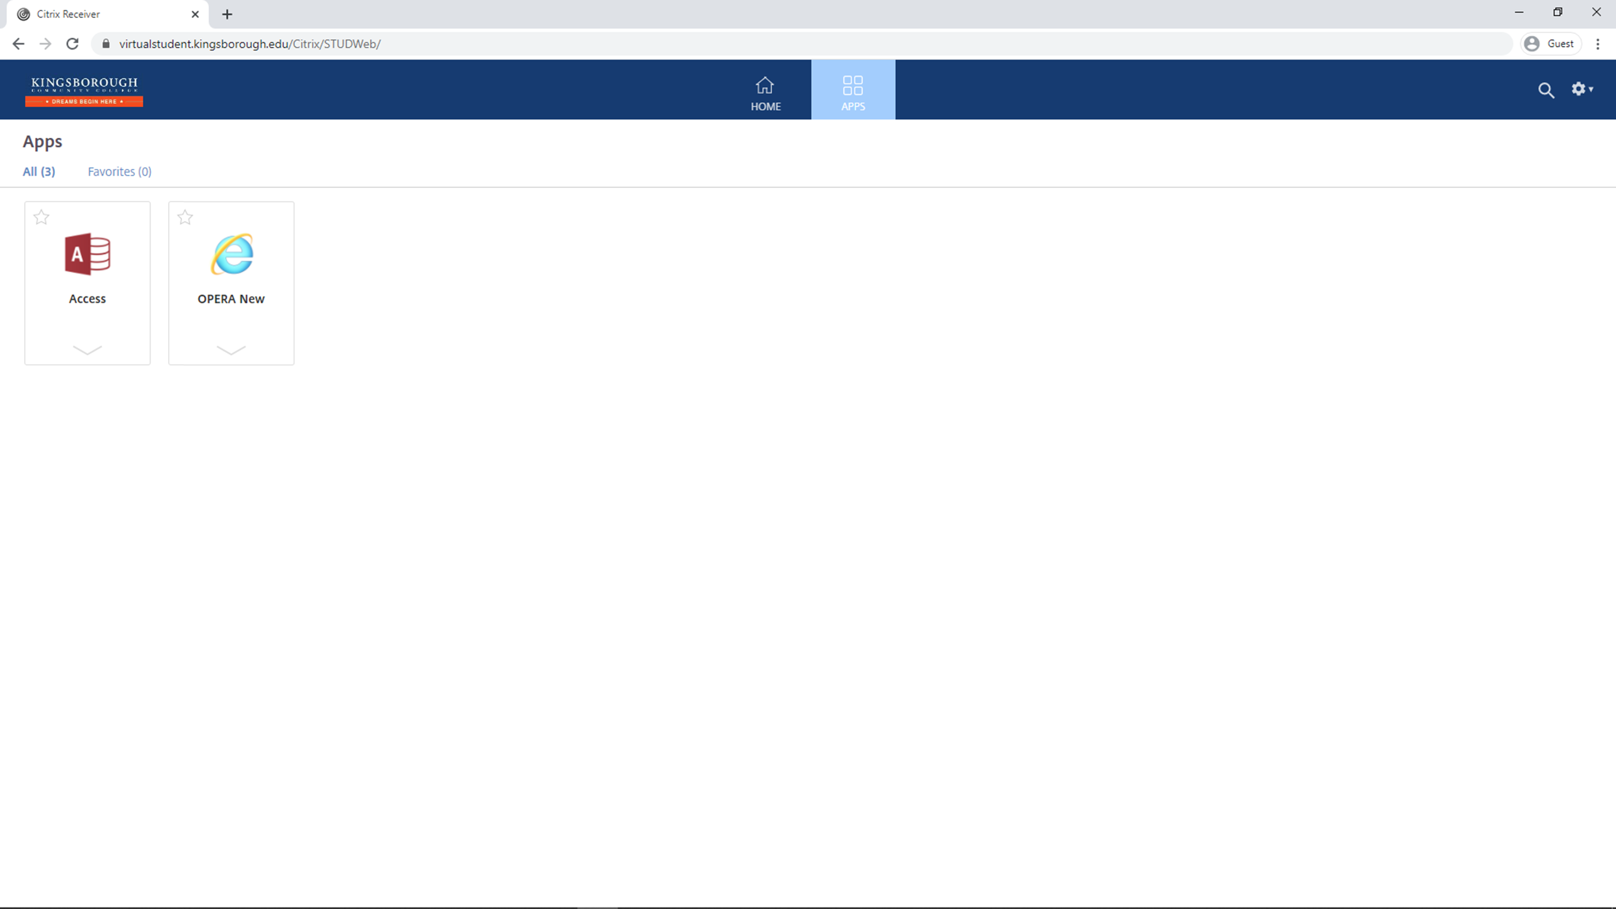
Click “Access”

Slide 18
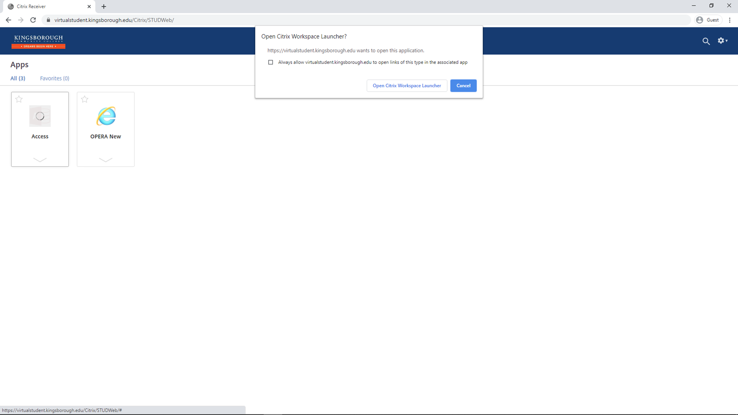
Click “Open Citrix Workspace Launcher”

Slide 19
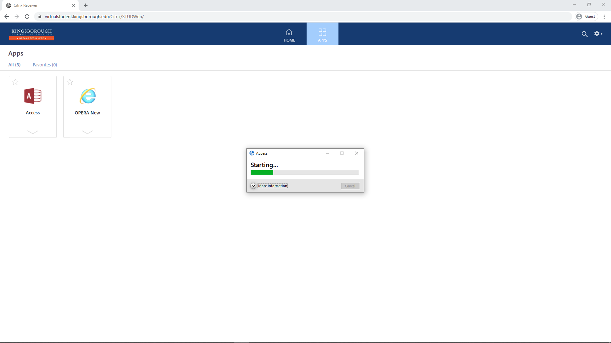
The application will begin starting

Slide 20
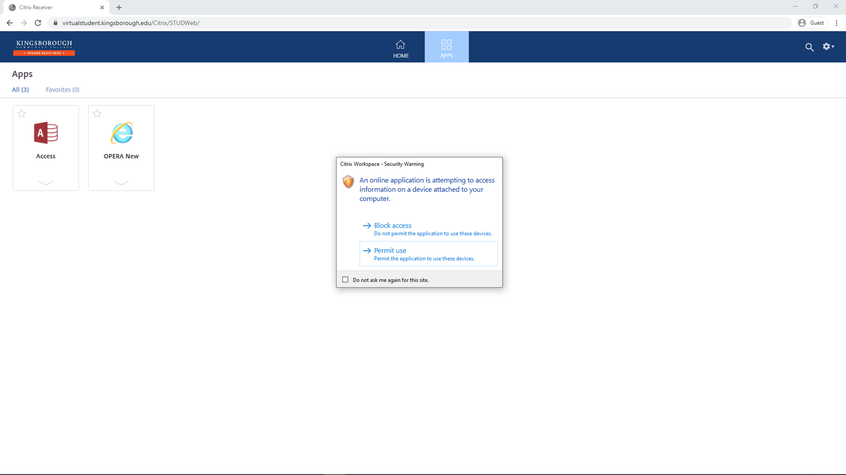
Click “Permit Use”

Slide 21
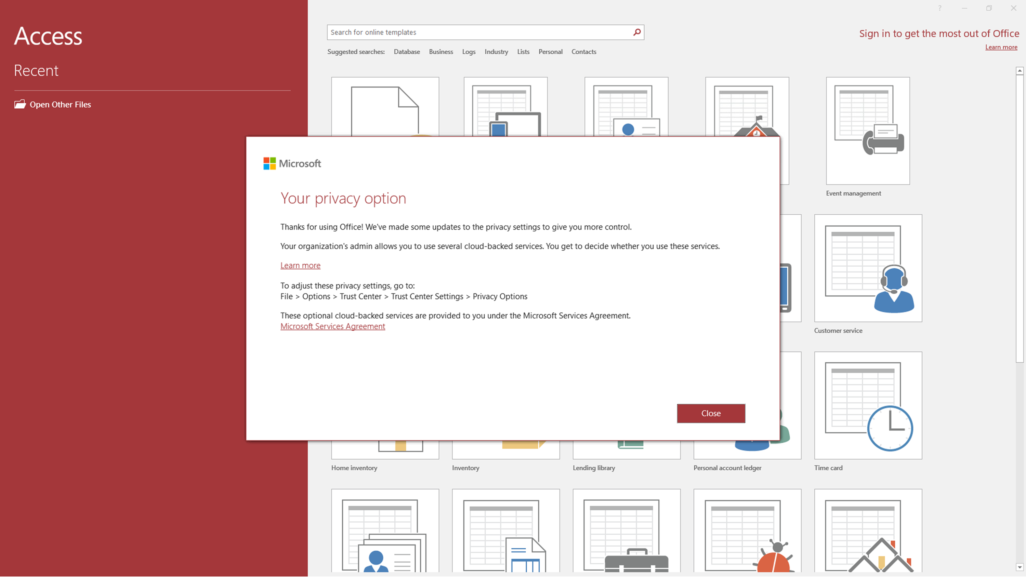
Access will now open

Slide 22
Click “Close”

Slide 23
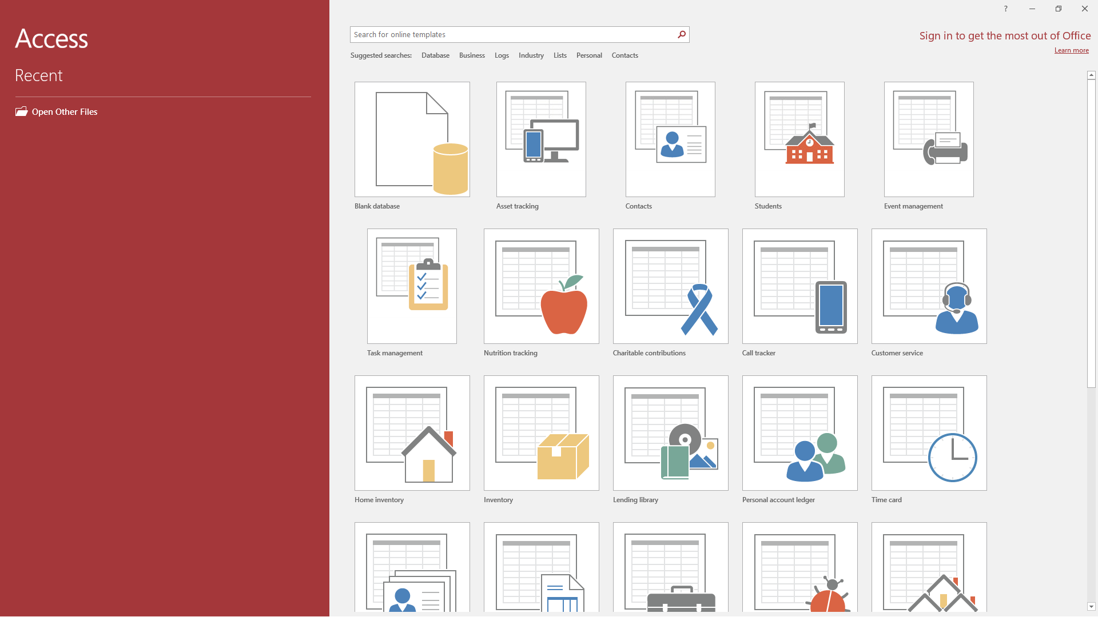
When saving or accessing files, make sure to use your classwork folder

Slide 24
Create a new file

Slide 25
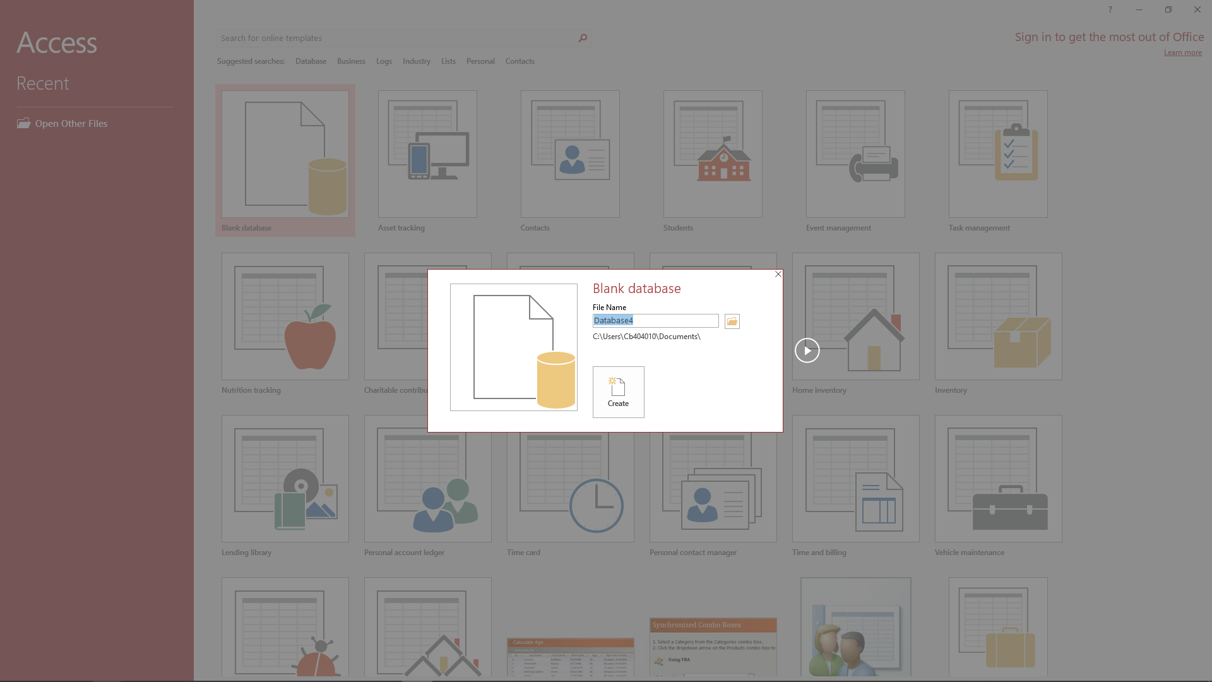
Click “Create”

Slide 26
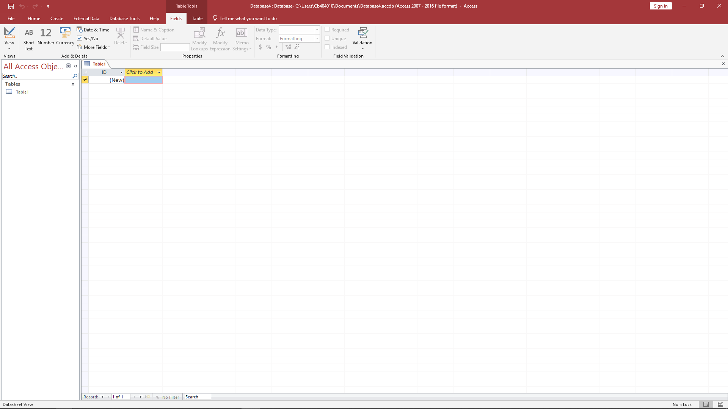
To save the file:
click “File”

Slide 27
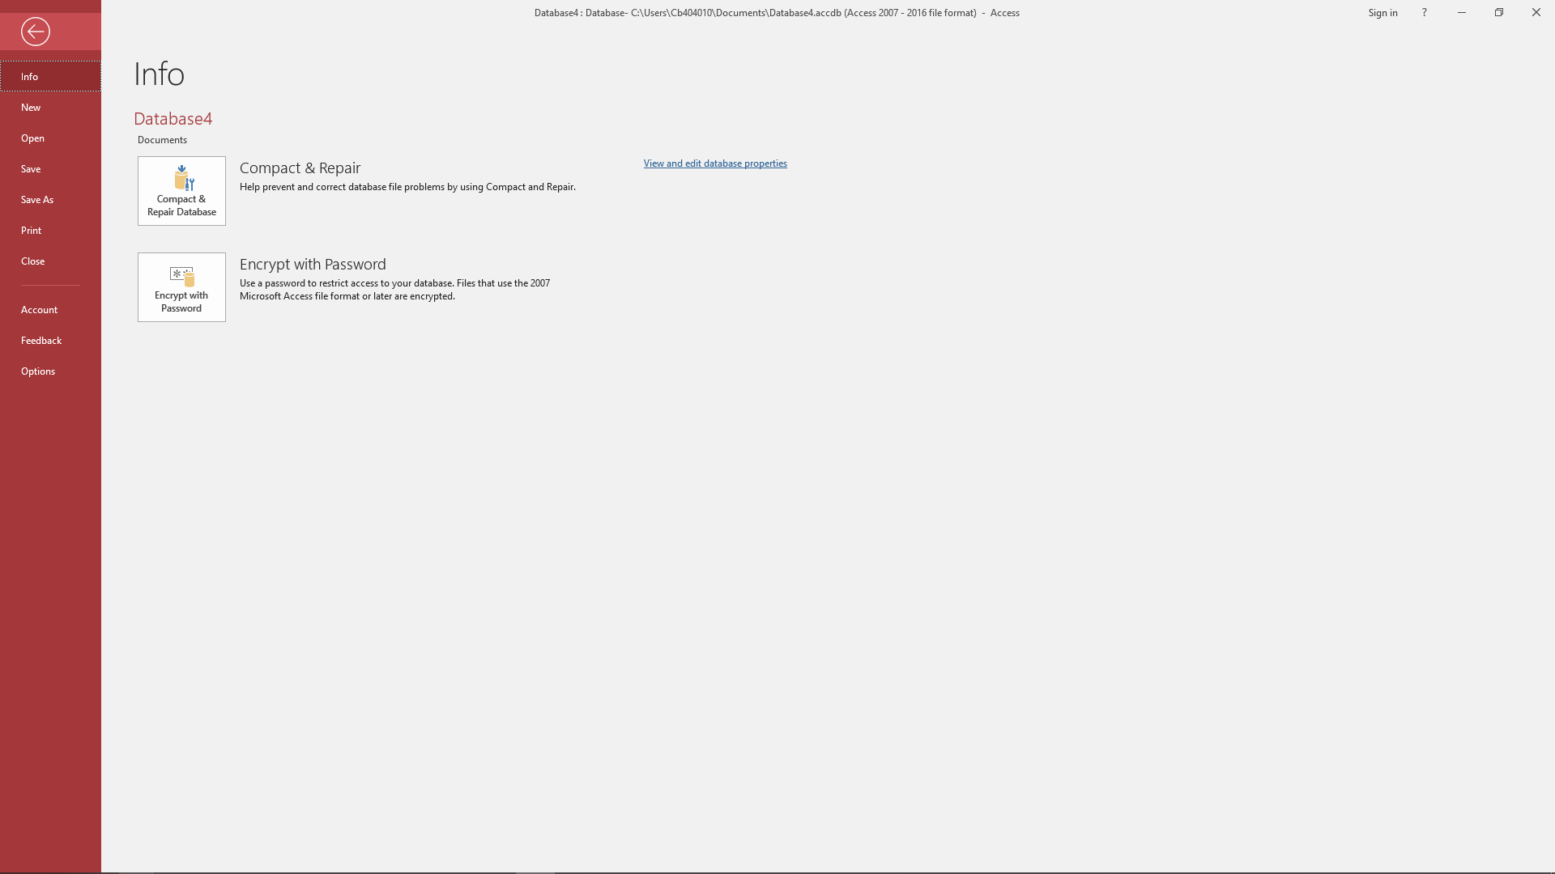
Click “Save As”

Slide 28
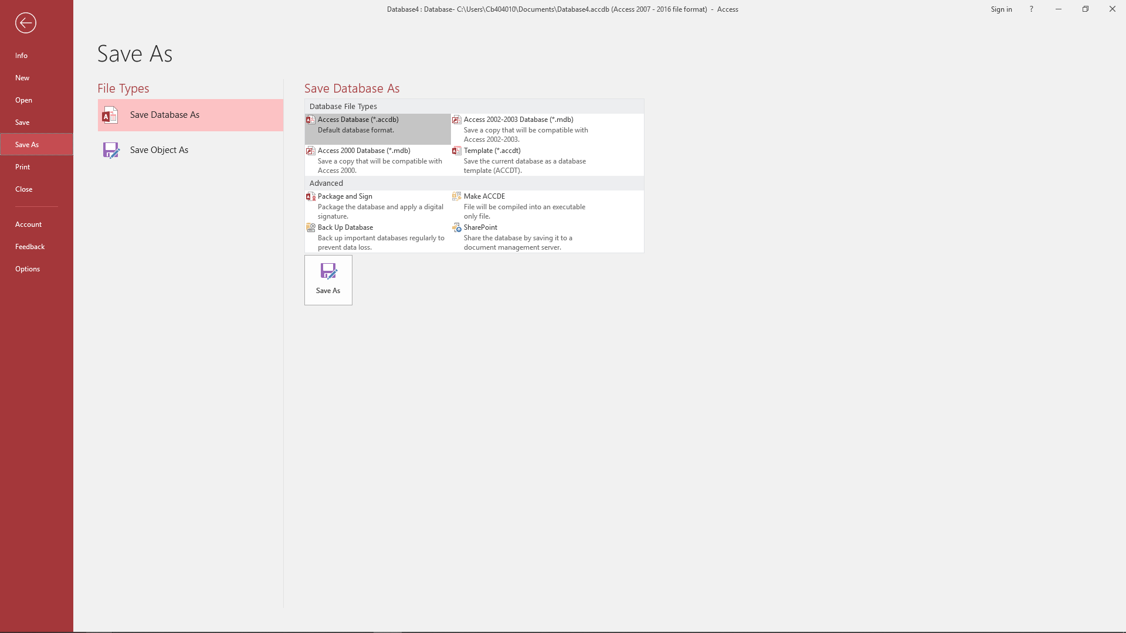
Click “Save As”

Slide 29
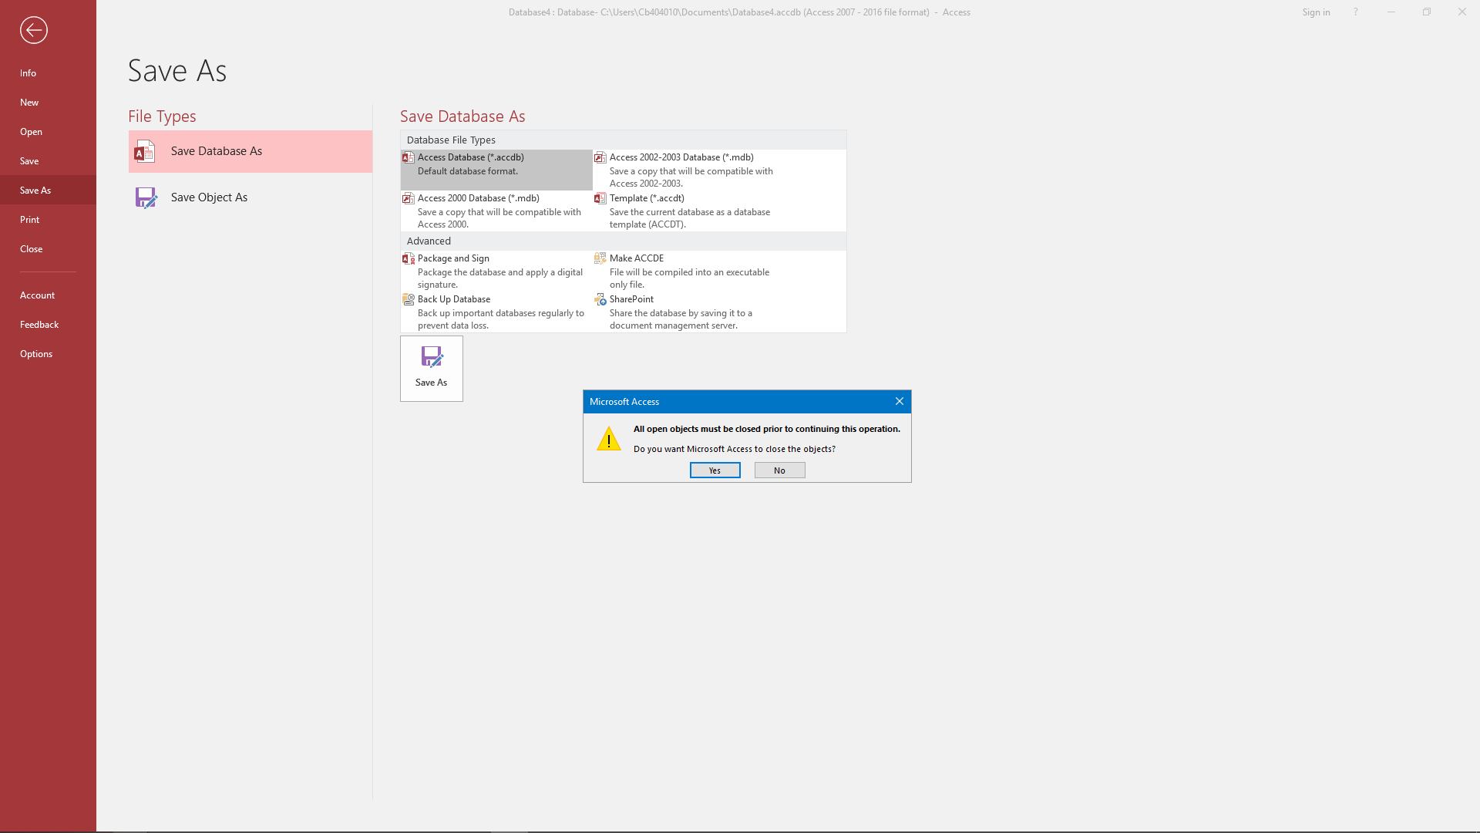
Click “Yes”

Slide 30
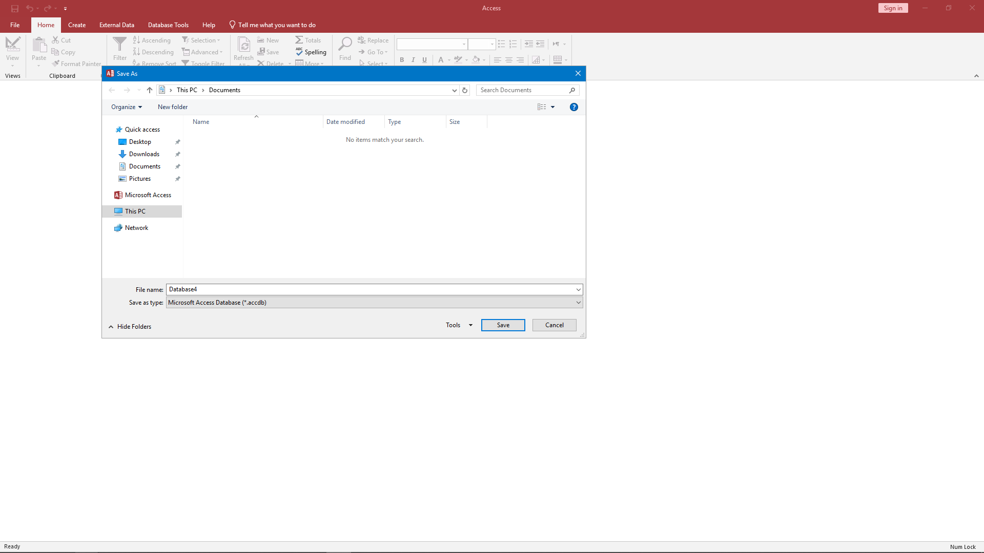
Click “This PC”

Slide 31
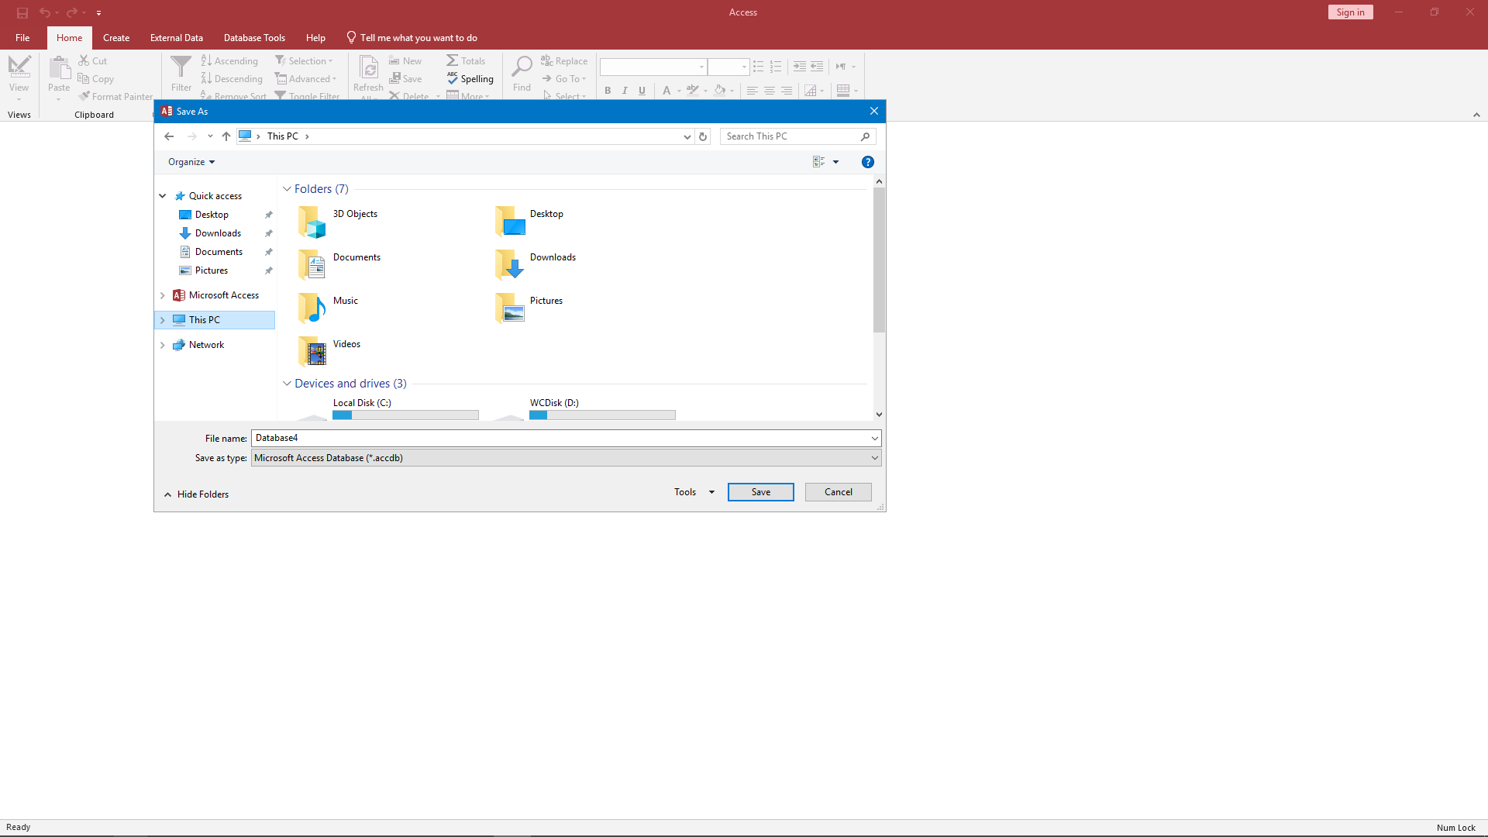
Scroll Down

Slide 32
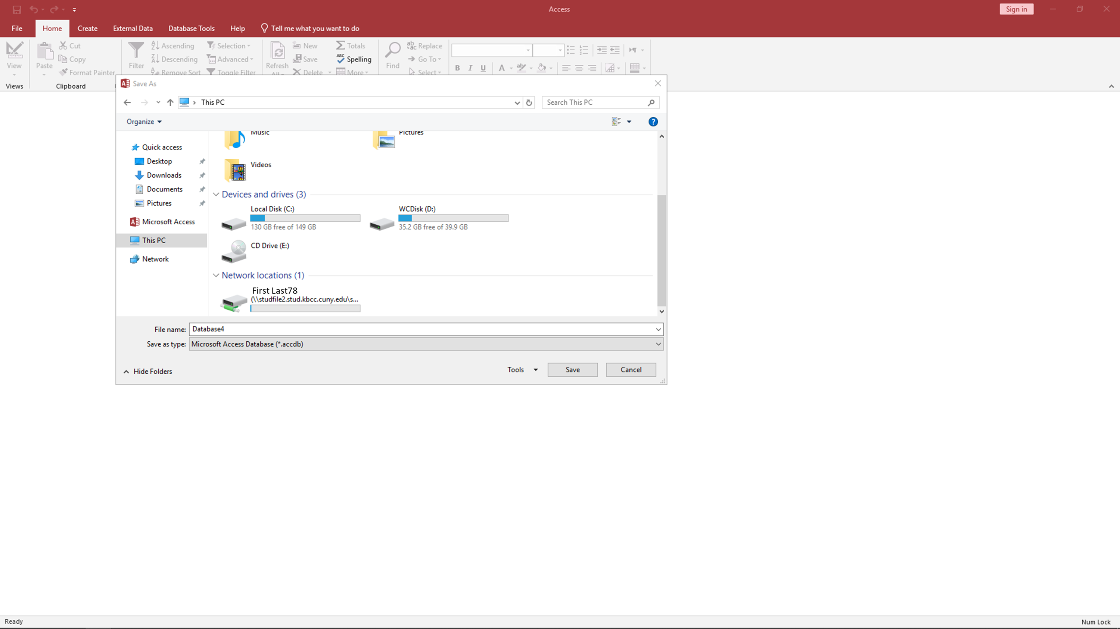
Open the Drive with your name

Slide 33

Click “Save”

Slide 34
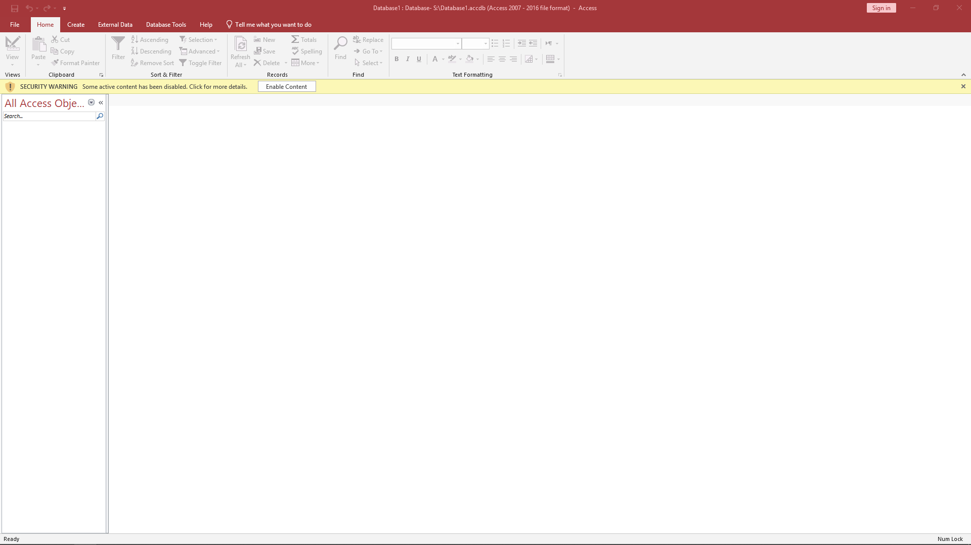
To open a saved file:
Click “file”

Slide 35
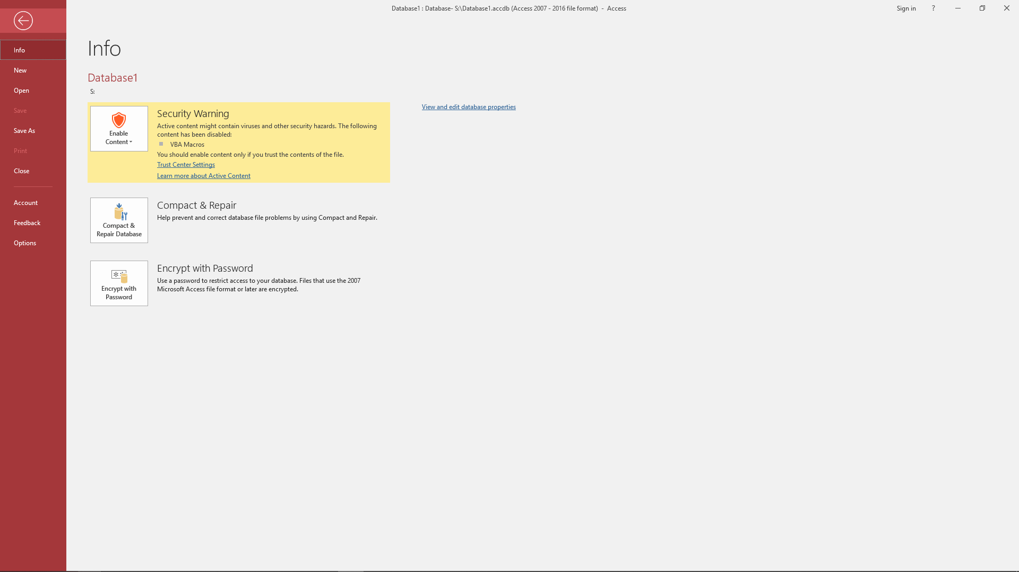
Click “Open”

Slide 36
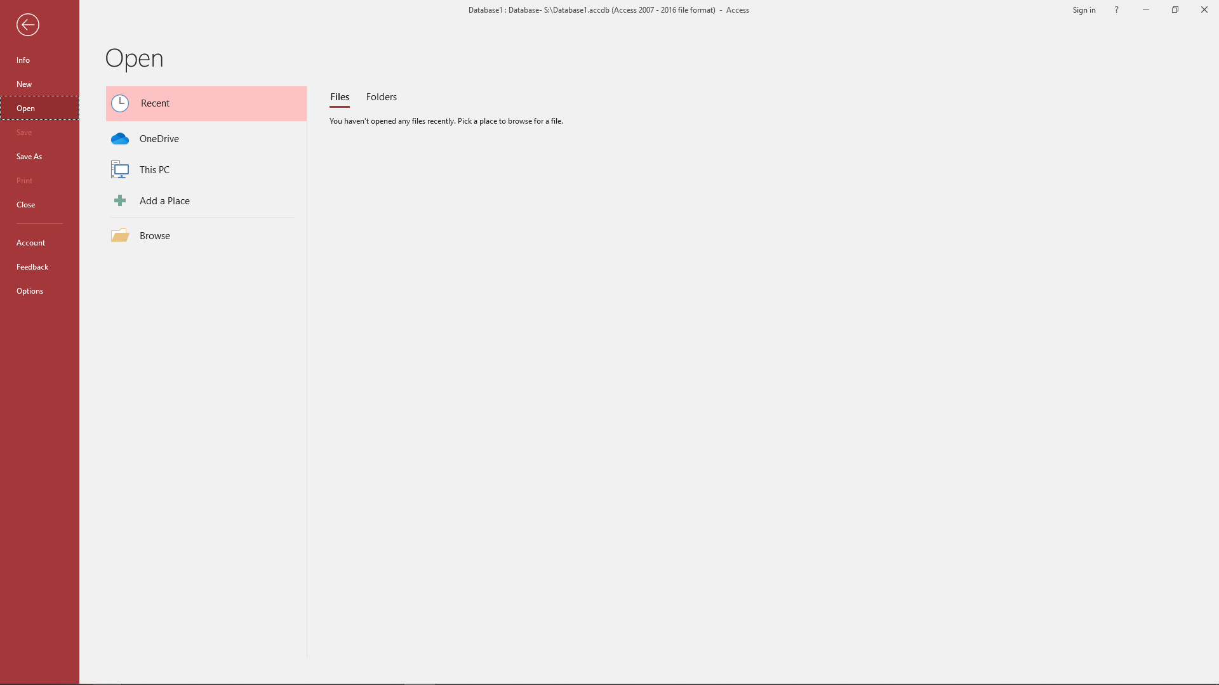
Click “Browse”

Slide 37
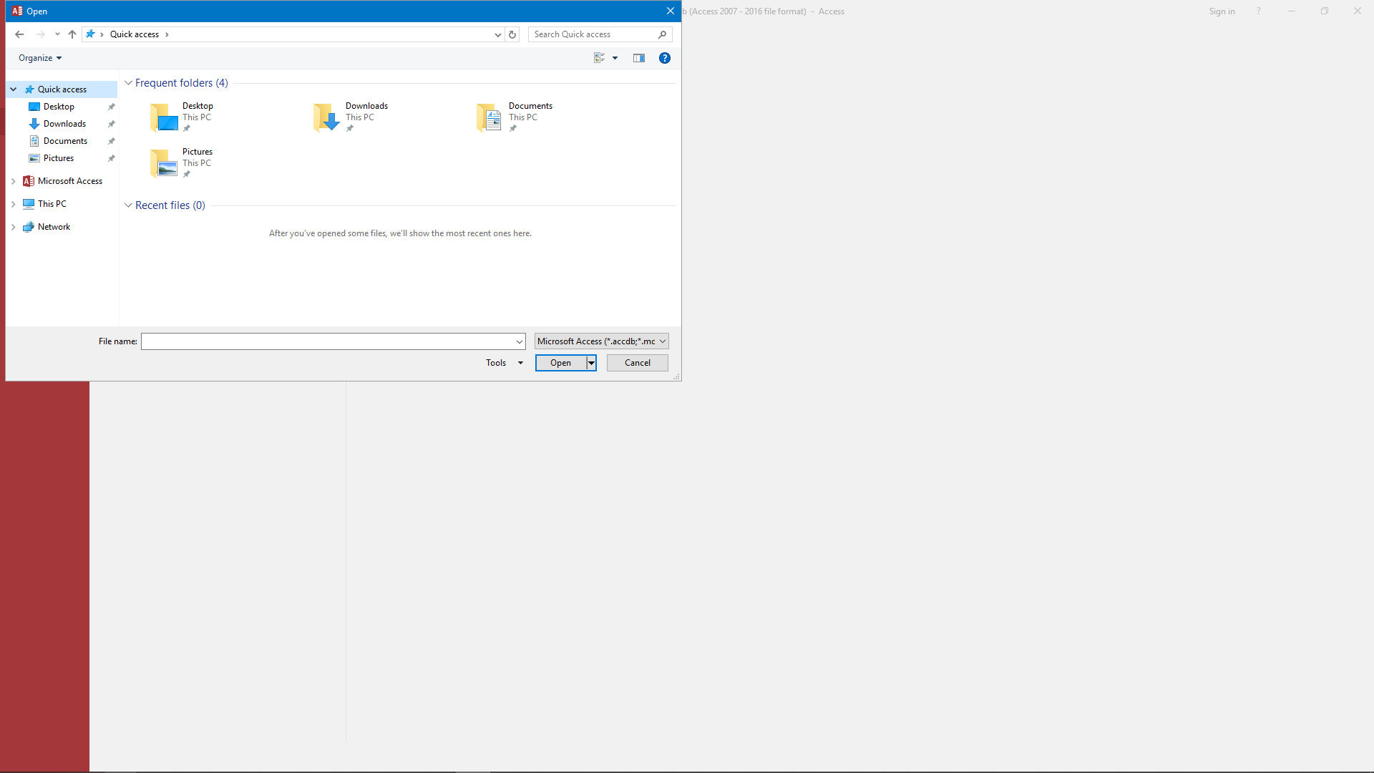
Click “This PC”

Slide 38
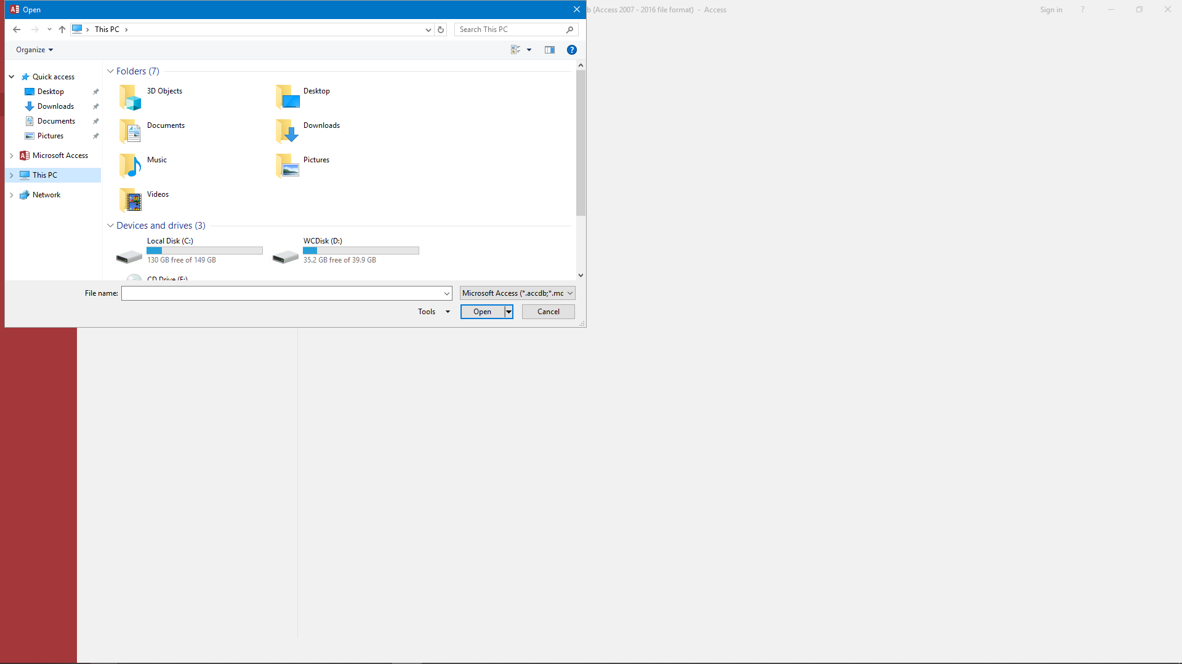
Scroll Down

Slide 39

Open the Drive with your name

Slide 40

Select the file you want to open

Slide 41

Click “Open”

Slide 42
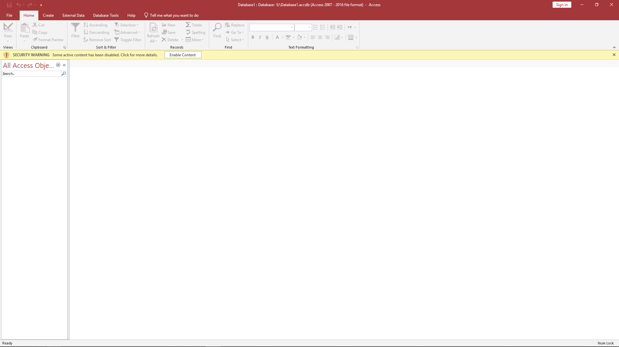
The file should now open

